Slide 1

GAME ANALYSIS WITH SQL
BY SALAUDEEN WAKILU OLADEJI

Slide 2
Overview of the Dataset
Dataset Name: Game Analysis Dataset
Tables Included:
Player Details: Information about players
Level Details: Game progression and performance metrics
Key Columns:
P_ID: Player ID
PName: Player Name
L1_status, L2_status: Status of Level 1 and Level 2 completion
L1_code, L2_code: System-generated codes for Level 1 and Level 2
Dev_ID: Device ID
start_time: Game session start time
stages_crossed: Number of stages crossed
level: Game level
difficulty: Game difficulty level
kill_count: Number of kills
headshots_count: Number of headshots
score: Player score
lives_earned: Extra lives earned

Slide 3
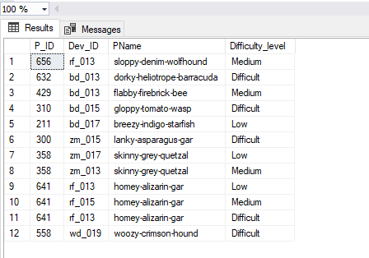
DECODING GAMING ANALYSIS
Extract P_ID, Dev_ID, PName and Difficulty_level of all players at level 0
SELECT p.P_ID, l.Dev_ID, p.PName, l.difficulty AS Difficulty_level
FROM player_details p
JOIN level_details2 l ON p.P_ID = l.P_ID
WHERE l.level = 0;

Slide 4
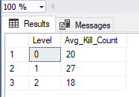
DECODING GAMING ANALYSIS
2. Find Level1_code wise Avg_Kill_Count where lives_earned is 2 and atleast
3 stages are crossed
SELECT Level, AVG(kill_count) AS Avg_Kill_Count
FROM level_details2
WHERE lives_earned = 2 AND stages_crossed >= 3
GROUP BY Level;

Slide 5
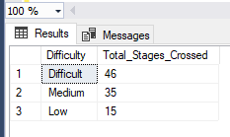
DECODING GAMING ANALYSIS
3. Find the total number of stages crossed at each diffuculty level-- where for
Level2 with players use zm_series devices. Arrange the result-- in decsreasing
order of total number of stages crossed.
SELECT Difficulty, SUM(Stages_crossed) AS Total_Stages_Crossed
FROM level_details2
WHERE Level = 2 AND Dev_ID LIKE 'zm%'
GROUP BY Difficulty
ORDER BY Total_Stages_Crossed DESC;

Slide 6
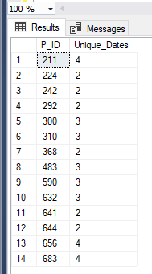
DECODING GAMING ANALYSIS
4. Extract P_ID and the total number of unique dates for those players -- who
have played games on multiple days.
SELECT P_ID, COUNT(DISTINCT CONVERT(date, StartDate)) AS Unique_Dates
FROM level_details2
GROUP BY P_ID
HAVING COUNT(DISTINCT CONVERT(date, StartDate)) > 1;

Slide 7
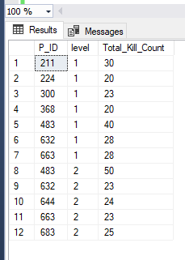
DECODING GAMING ANALYSIS
5. Find P_ID and level wise sum of kill_counts where kill_count-- is greater than
avg kill count for the Medium difficulty.
WITH AvgKillCount AS (
SELECT AVG(kill_count) AS Avg_Kill_Count
FROM level_details2
WHERE difficulty = 'Medium'
)
SELECT l.P_ID, l.level, SUM(l.kill_count) AS Total_Kill_Count
FROM level_details2 l, AvgKillCount a
WHERE l.difficulty = 'Medium'
AND l.kill_count > a.Avg_Kill_Count
GROUP BY l.P_ID, l.level;

Slide 8
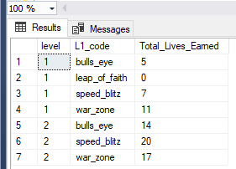
DECODING GAMING ANALYSIS
6. Find Level and its corresponding Level code wise sum of lives earned excluding
level 0. Arrange in ascending order of level.
SELECT level, p.L1_code, SUM(lives_earned) AS Total_Lives_Earned
FROM level_details2 l
JOIN player_details p ON l.P_ID = p.P_ID
WHERE level <> 0
GROUP BY level, p.L1_code
ORDER BY level ASC;

Slide 9
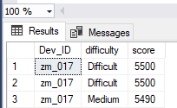
DECODING GAMING ANALYSIS
7. Find Top 3 score based on each dev_id and Rank them in increasing order–
using Row_Number. Display difficulty as well.
WITH RankedScores AS (
SELECT Dev_ID, difficulty, score,
ROW_NUMBER() OVER (PARTITION BY Dev_ID ORDER BY score DESC) AS Rank
FROM level_details2
)
SELECT Dev_ID, difficulty, score
FROM RankedScores
WHERE Rank <= 3
ORDER BY Score DESC, Rank ASC;

Slide 10
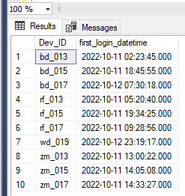
DECODING GAMING ANALYSIS
8. Find first_login datetime for each device id
SELECT Dev_ID, MIN(StartDate) AS first_login_datetime
FROM level_details2
GROUP BY Dev_ID;

Slide 11
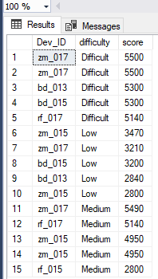
DECODING GAMING ANALYSIS
9. Find Top 5 score based on each difficulty level and Rank them in -- increasing
order using Rank. Display dev_id as well.
WITH RankedScores AS (
SELECT Dev_ID, difficulty, score,
ROW_NUMBER() OVER (PARTITION BY difficulty ORDER BY score DESC) AS Rank
FROM level_details2
)
SELECT Dev_ID, difficulty, score
FROM RankedScores
WHERE Rank <= 5
ORDER BY difficulty ASC, Rank ASC;

Slide 12
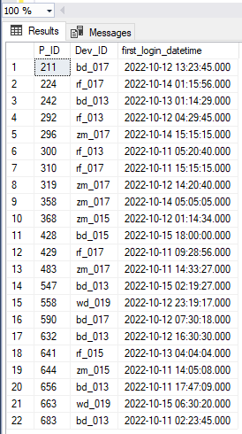
DECODING GAMING ANALYSIS
10. Find the device ID that is first logged in(based on start_datetime) -- for each player(p_id). Output should contain player id, device id and -- first login datetime.
SELECT l.P_ID, l.Dev_ID, l.StartDate AS first_login_datetime
FROM level_details2 l
INNER JOIN (
SELECT P_ID, MIN(StartDate) AS min_start_time
FROM level_details2
GROUP BY P_ID
) AS first_login ON l.P_ID = first_login.P_ID AND l.StartDate = first_login.min_start_time;

Slide 13
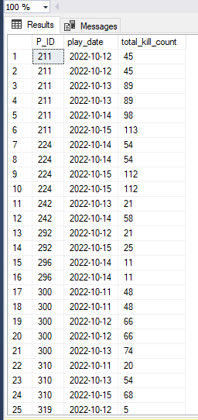
DECODING GAMING ANALYSIS
11. For each player and date, how many kill_count played so far by the player. That is,
the total number of games played -- by the player until that date.
a) window function
SELECT P_ID, CAST(StartDate AS date) AS play_date,
SUM(kill_count) OVER (PARTITION BY P_ID ORDER BY CAST(StartDate AS date)) AS total_kill_count
FROM level_details2
ORDER BY P_ID, CAST(StartDate AS date);

Slide 14
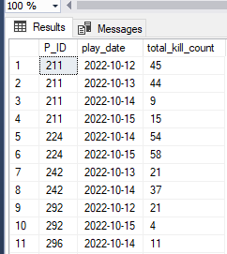
DECODING GAMING ANALYSIS
11. For each player and date, how many kill_count played so far by the player. That is,
the total number of games played -- by the player until that date.
b) without window function
SELECT ld.P_ID, CAST(ld.StartDate AS date) AS play_date,
SUM(ld.kill_count) AS total_kill_count
FROM level_details2 ld
WHERE CAST(ld.StartDate AS date) <= (
SELECT MAX(CAST(ld_inner.StartDate AS date))
FROM level_details2 ld_inner
WHERE ld_inner.P_ID = ld.P_ID
)
GROUP BY ld.P_ID, CAST(ld.StartDate AS date)
ORDER BY ld.P_ID, CAST(ld.StartDate AS date);

Slide 15
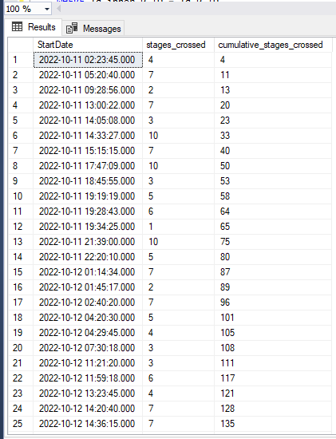
DECODING GAMING ANALYSIS
12. Find the cumulative sum of stages crossed over a start_datetime
SELECT P_ID, StartDate, stages_crossed,
SUM(stages_crossed) OVER (ORDER BY StartDate) AS cumulative_stages_crossed
FROM level_details2
ORDER BY StartDate;

Slide 16
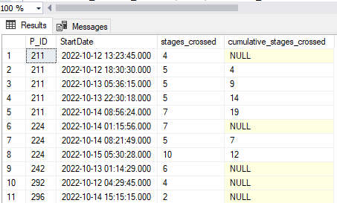
DECODING GAMING ANALYSIS
13. Find the cumulative sum of an stages crossed over a start_datetime for each player id
but exclude the most recent start_datetime
WITH RankedStages AS (
SELECT P_ID, StartDate, stages_crossed,
ROW_NUMBER() OVER (PARTITION BY P_ID ORDER BY StartDate DESC) AS rn
FROM level_details2
)
SELECT P_ID, StartDate, stages_crossed,
SUM(Stages_crossed) OVER (PARTITION BY P_ID ORDER BY StartDate ASC ROWS BETWEEN UNBOUNDED PRECEDING AND 1 PRECEDING) AS cumulative_stages_crossed
FROM RankedStages
WHERE rn > 1
ORDER BY P_ID, StartDate;

Slide 17
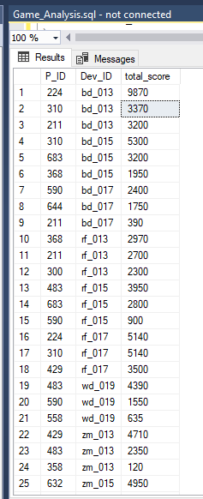
DECODING GAMING ANALYSIS
14. Extract top 3 highest sum of score for each device id and the corresponding player_id
WITH RankedScores AS (
SELECT P_ID, Dev_ID, SUM(score) AS total_score,
ROW_NUMBER() OVER (PARTITION BY Dev_ID ORDER BY SUM(score) DESC) AS rn
FROM level_details2
GROUP BY P_ID, Dev_ID
)
SELECT P_ID, Dev_ID, total_score
FROM RankedScores
WHERE rn <= 3
ORDER BY Dev_ID, total_score DESC;;

Slide 18
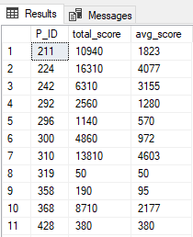
DECODING GAMING ANALYSIS
15. Find players who scored more than 50% of the avg score scored by sum of -- scores for
each player_id
WITH PlayerAvgScores AS (
SELECT P_ID, AVG(score) AS avg_score
FROM level_details2
GROUP BY P_ID
)
SELECT ld.P_ID, SUM(ld.score) AS total_score, pas.avg_score
FROM level_details2 ld
JOIN PlayerAvgScores pas ON ld.P_ID = pas.P_ID
GROUP BY ld.P_ID, pas.avg_score
HAVING SUM(ld.score) > 0.5 * pas.avg_score
ORDER BY ld.P_ID;

Slide 19
DECODING GAMING ANALYSIS
16. Create a stored procedure to find top n headshots_count based on each dev_id and Rank
them in increasing order using Row_Number. Display difficulty as well..
CREATE PROCEDURE GetTopNHeadshotsCountByDevID
@n INT
AS
BEGIN
SET NOCOUNT ON;
WITH RankedHeadshots AS (
SELECT Dev_ID, difficulty, headshots_count,
ROW_NUMBER() OVER (PARTITION BY Dev_ID ORDER BY headshots_count ASC) AS rn
FROM level_details2
)
SELECT Dev_ID, difficulty, headshots_count
FROM RankedHeadshots
WHERE rn <= @n
ORDER BY Dev_ID ASC, headshots_count ASC;
END;
;

Slide 20
DECODING GAMING ANALYSIS
17. Create a function to return sum of Score for a given player_id.
CREATE FUNCTION GetTotalScoreForPlayer
(
@P_ID INT
)
RETURNS INT
AS
BEGIN
DECLARE @TotalScore INT;
SELECT @TotalScore = SUM(score)
FROM level_details2
WHERE P_ID = @P_ID;
RETURN @TotalScore;
END;

Slide 21
SUMMARY
The game analysis provided valuable insights into player behavior and performance within the game environment. Through the examination of various metrics such as player scores, difficulty levels chosen, and headshots counts, we gained a deeper understanding of player engagement and skill levels.

Slide 22
KEY FINDINGS
Player Engagement: The majority of players showed high levels of engagement, with multiple levels completed by most.
Difficulty Levels: A significant number of players opted for Medium difficulty, indicating a balanced gameplay experience. Easy and Hard difficulty levels also saw participation, catering to players of different skill levels.
Skill Levels: The headshots count revealed that many players exhibited skilled gameplay, achieving headshots in their gameplay sessions.
Device Usage: Varied device usage was observed, with players accessing the game across a range of device IDs.

